Slide 1

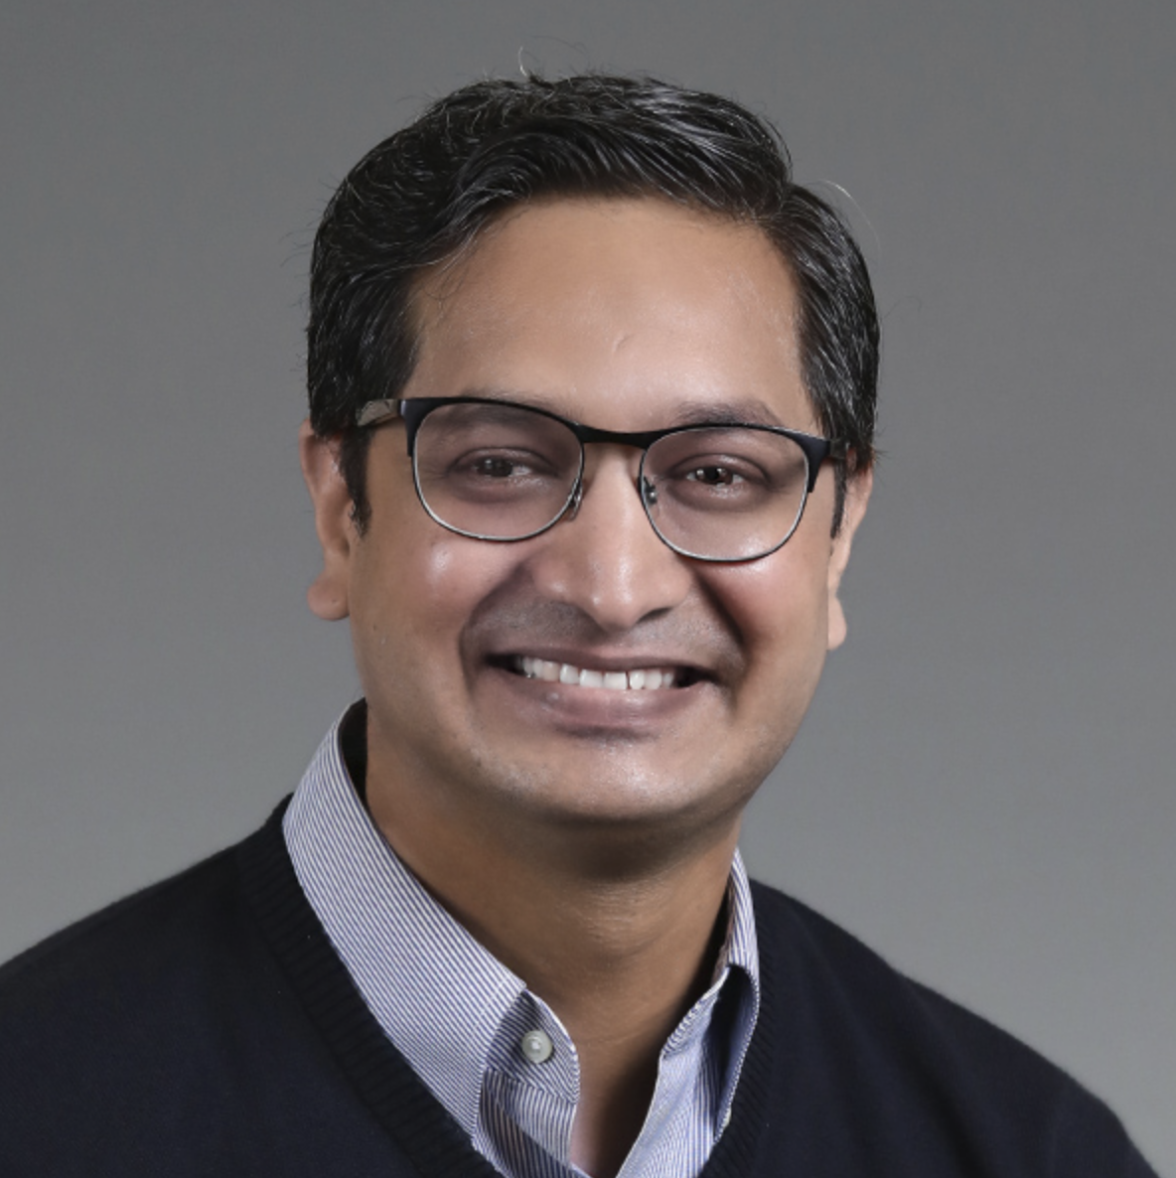
Workshop
Mastering Stable Diffusion
Module 2
Understanding Deeper levels of Diffusion Models
Sandeep Singh
Head of Applied AI, Beans AI

Slide 2

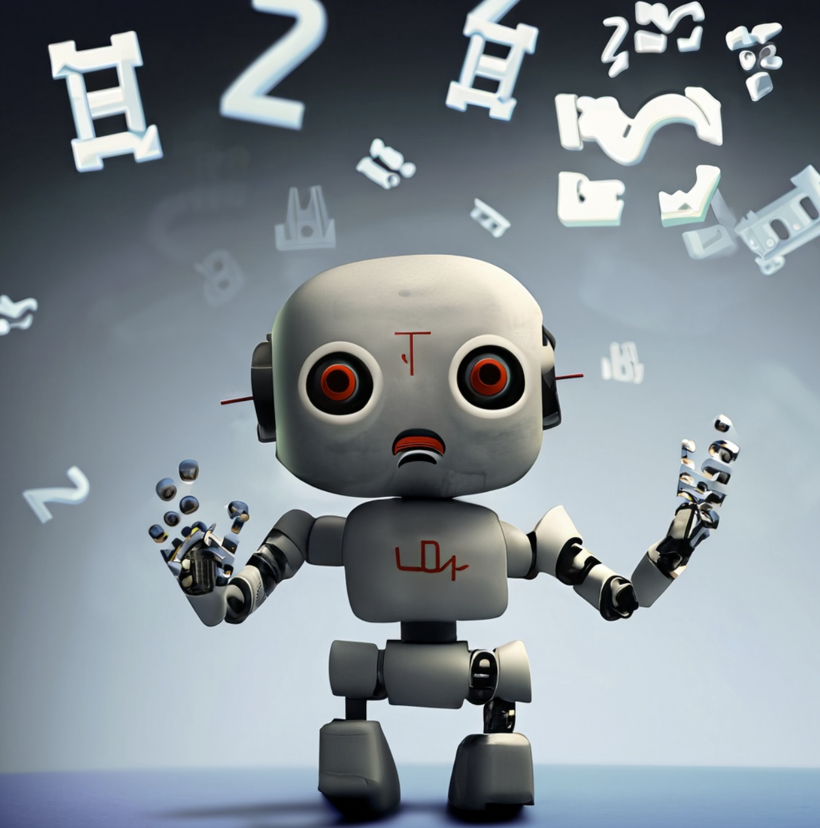
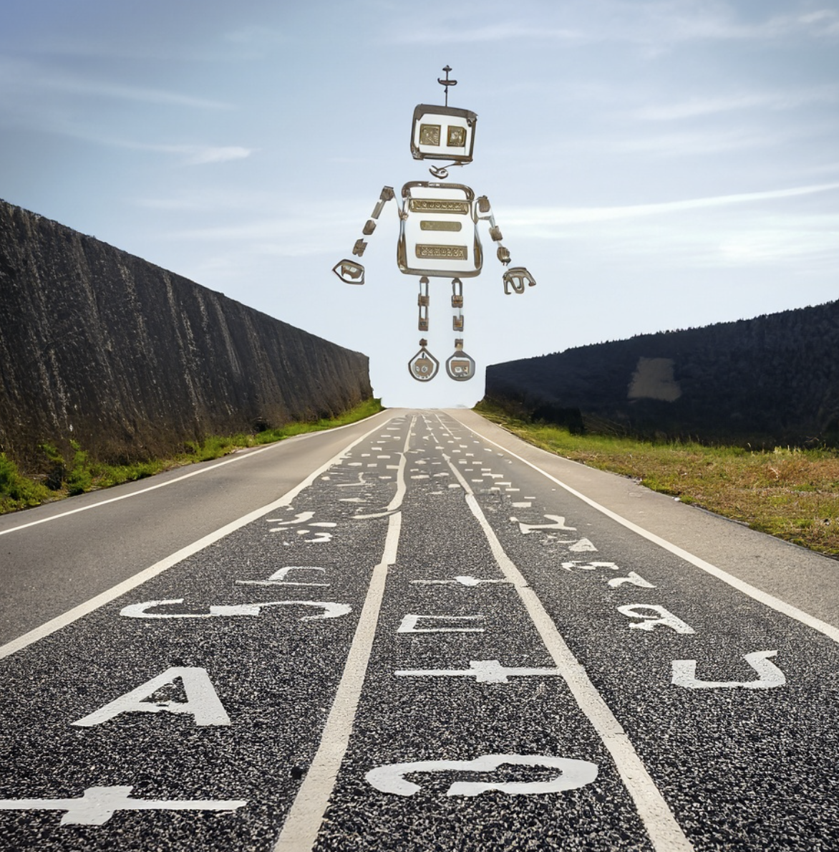
Maths Ahead: Not so Excited?

Slide 3
Module 2 Purpose
Know all the math for Stable Diffusion.
Understand Noising and Sampling Schedule.
Understand the inherent Latents.
Deeper Understanding of Variational Autoencoders(VAE)
Code Diffusion Process.
Implement and Train Stable Diffusion for Fashion MNIST Images.
Understand papers: CLIP GLIDE Dall-E2
Text/Prompt Conditioning.
Rediscover CLIP.
Question Answers and help.

Slide 4
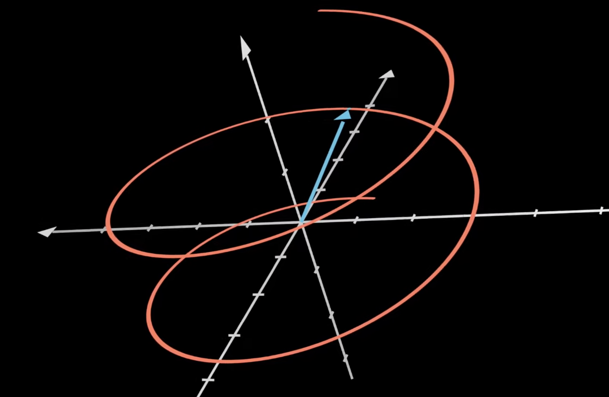
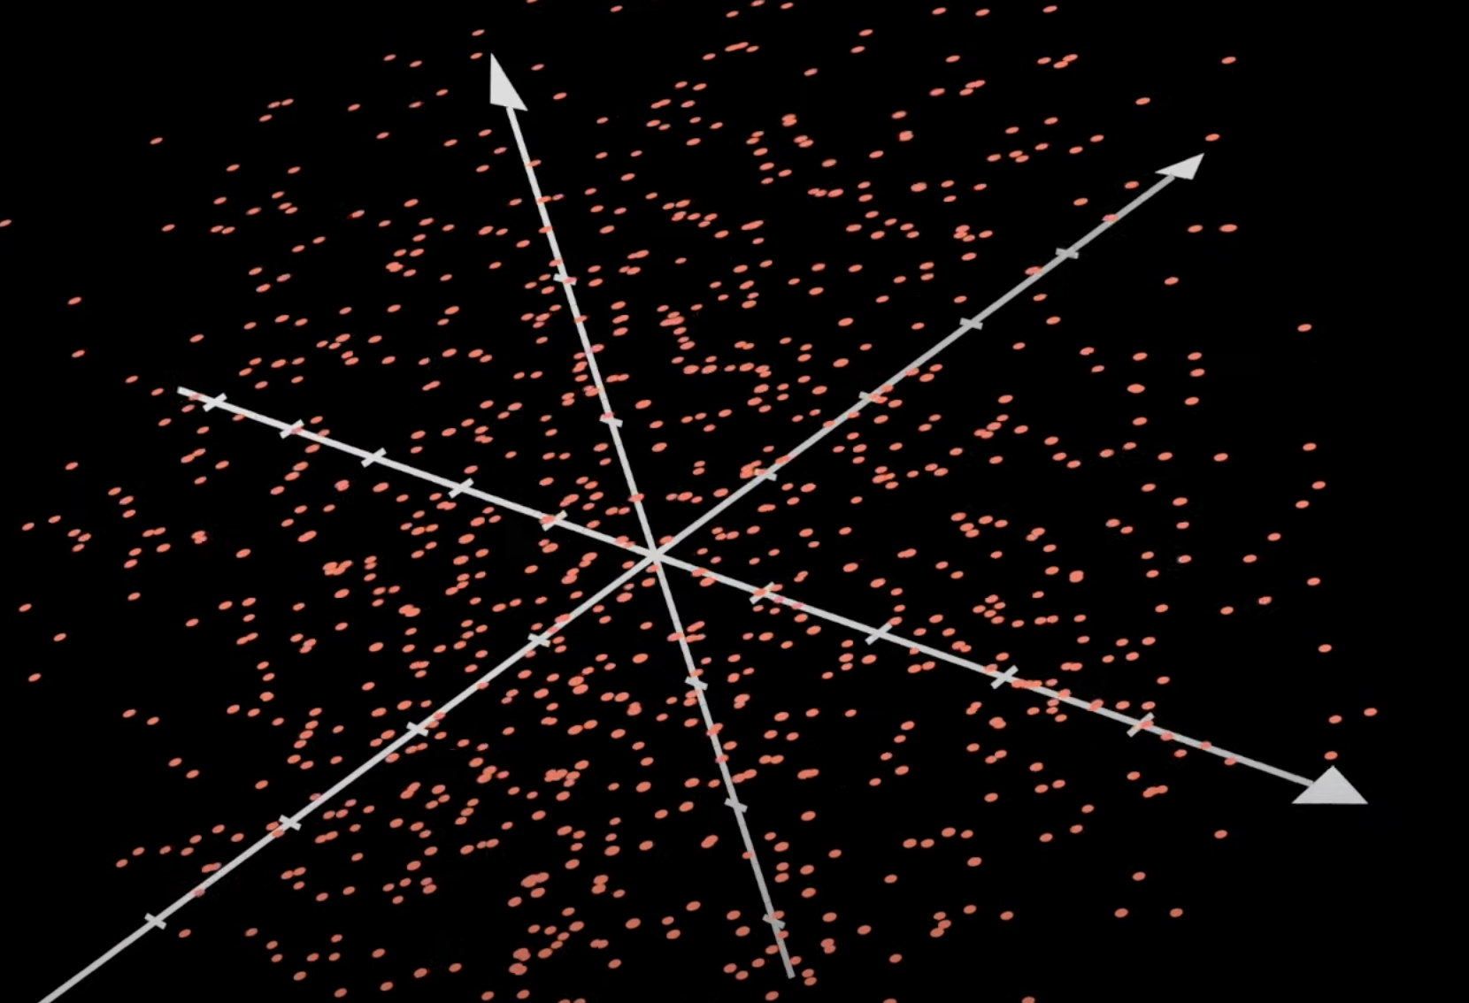
Paper: Variational Autoencoder(VAE)
Original VAE paper: https://arxiv.org/abs/1312.6114
It is precursor to many GAN type research.
VAE Inspired many Stable Diffusion mathematical research directions.
Fundamental in understanding Stable Diffusion.
Still used in many modern day ML and DL applications.
Easy to code and train.
Supports many efficient research and applications.
Good Candidate for VAE
Not A Candidate for VAE

Slide 5
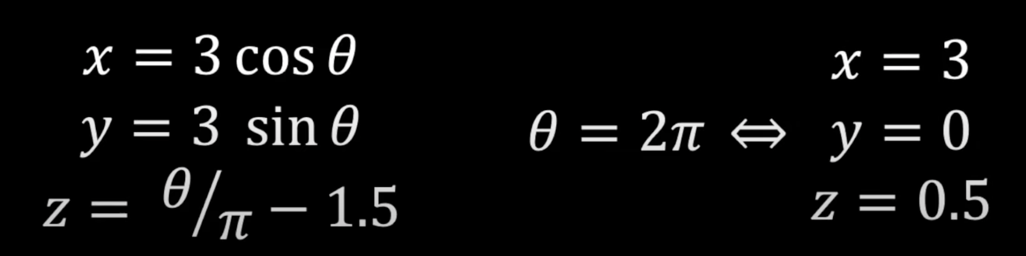
Paper: Variation Auto Encoder(VAE)
Whole Helix shape data , which is 3-dimension originally can be represented by single value of theta.
⇒

Slide 6
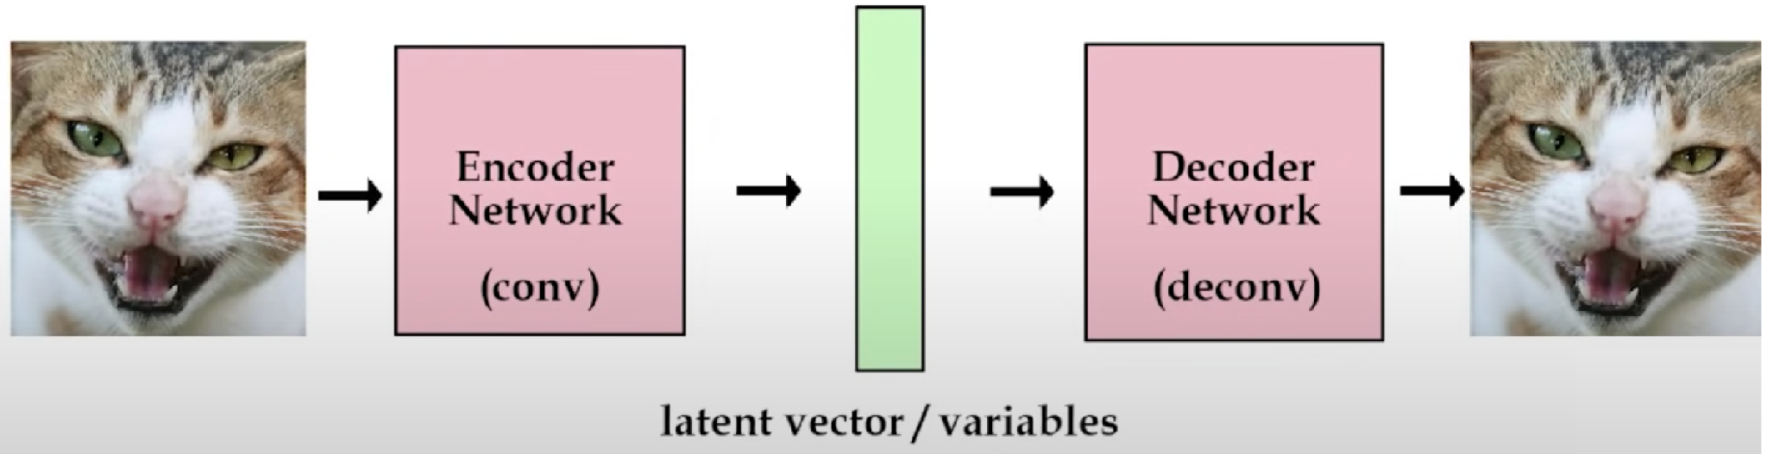
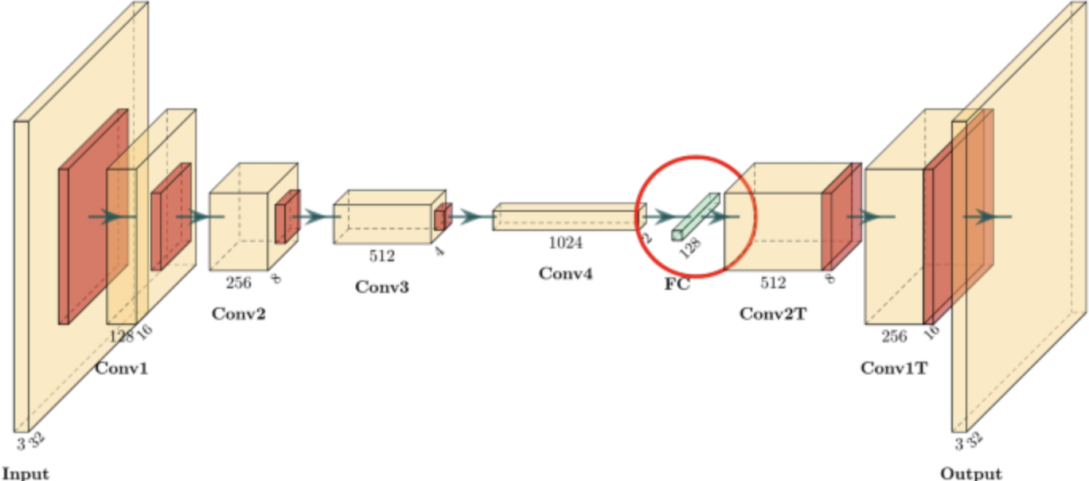
Paper: Variation Auto Encoder(VAE)
Bottleneck

Slide 7
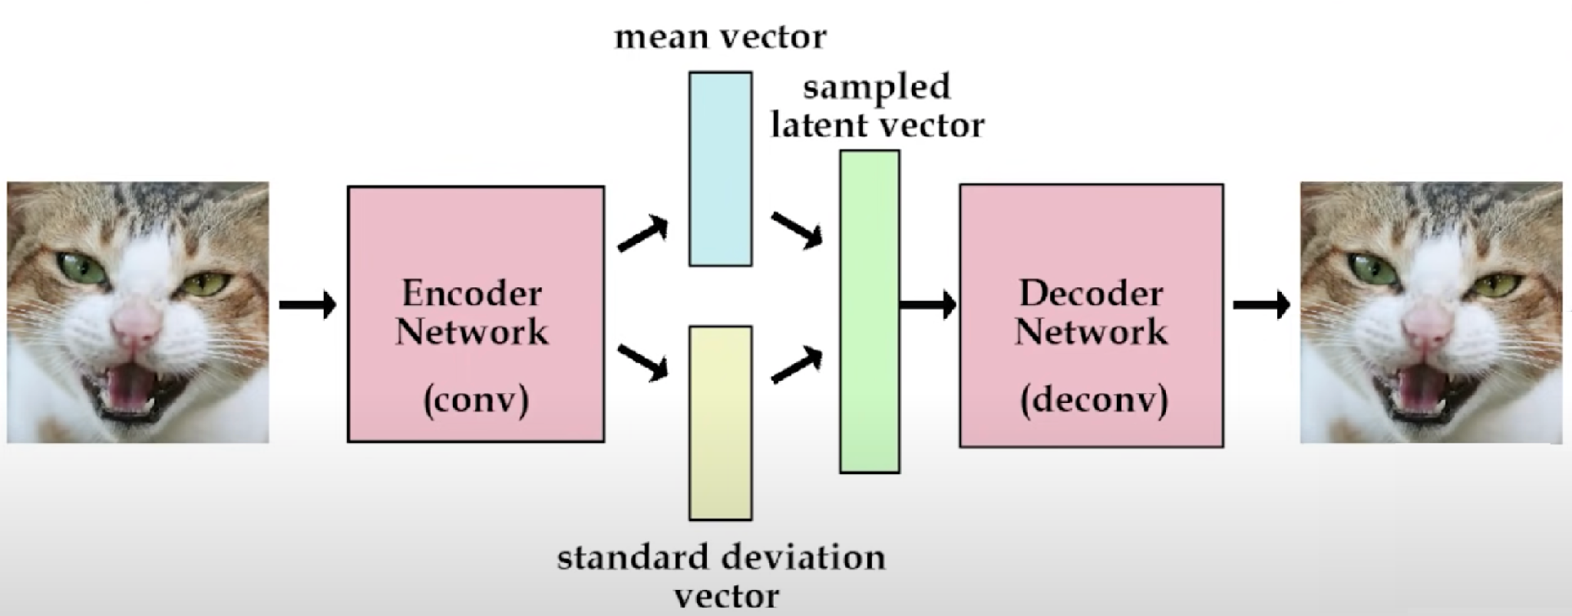
Paper: Variation Auto Encoder(VAE)
Traditional Autoencoder
Additional in Variational Autoencoder
Variational Autoencoder
Reconstructions Loss
Data Distribution Loss from Gaussian

Slide 8
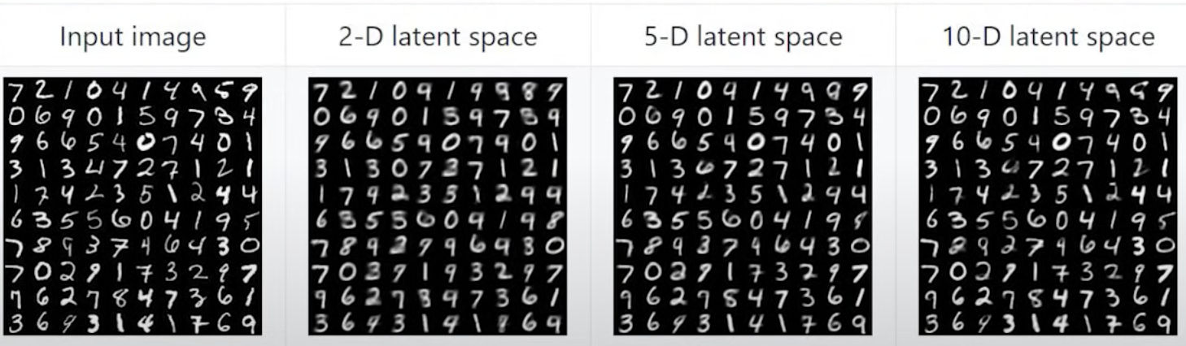
Paper: Variation Auto Encoder(VAE)
Effect of Bottleneck
Wider the Bottleneck, More information it can carry. Higher the latent dimensions, more resolution it can support.

Slide 9
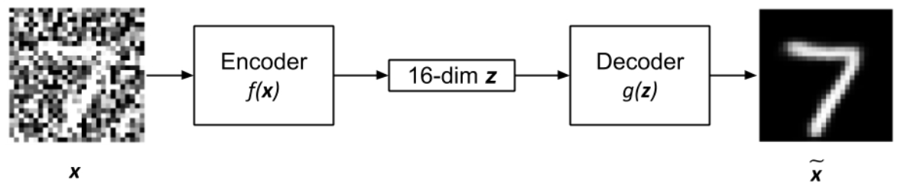
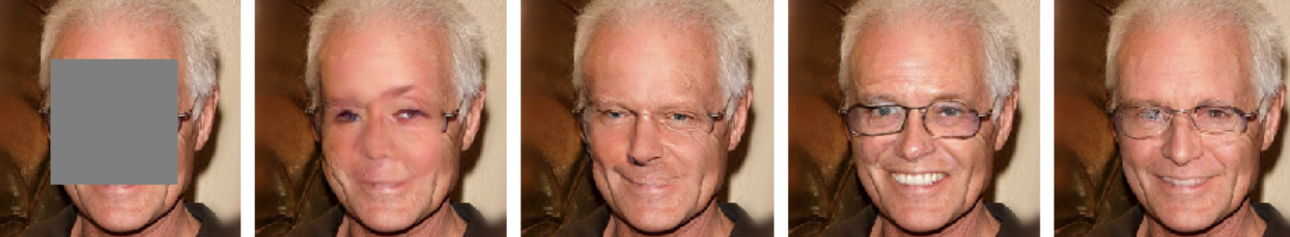
Paper: Variation Auto Encoder(VAE)
Few Applications of VAE
Denoising
In-painting
That is all you need to know for Stable Diffusion in this module.
If still hazy about it, Don’t worry about it.

Slide 10
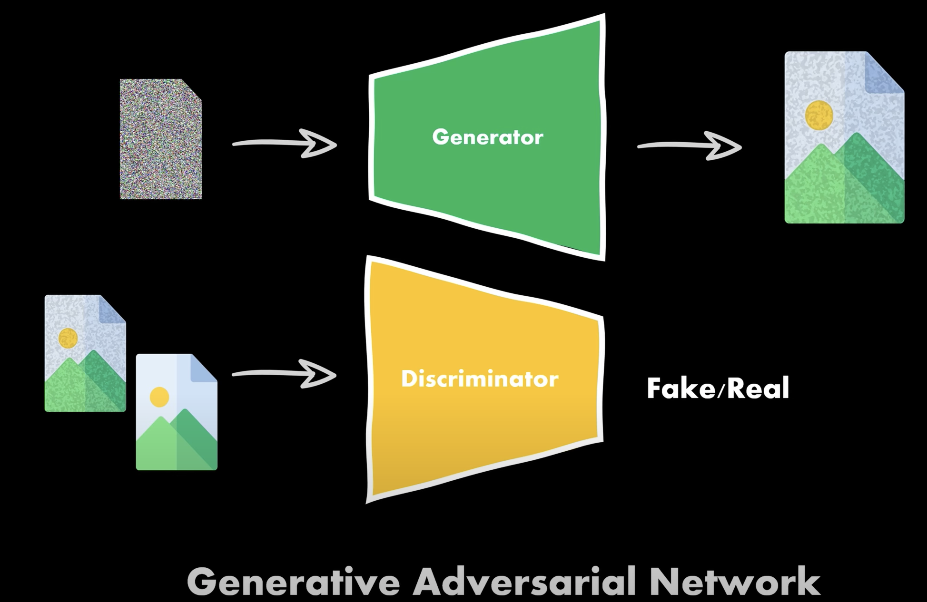
Before Stable Diffusion: A word GANs
Similar to SD: Generate Images learned from random noise.
Suffer from many setbacks as: Vanishing Gradients Mode Collapse(Single or Similar type of output)
Hence, Very Hard to Train.
That is where we are look towards Stable Diffusion.

Slide 11
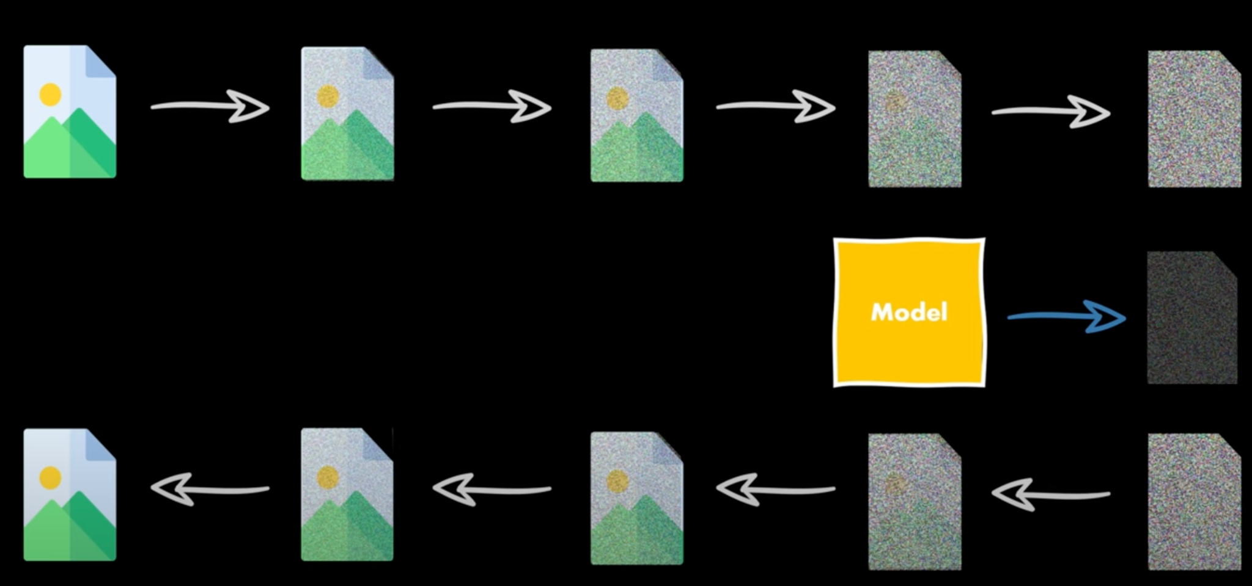
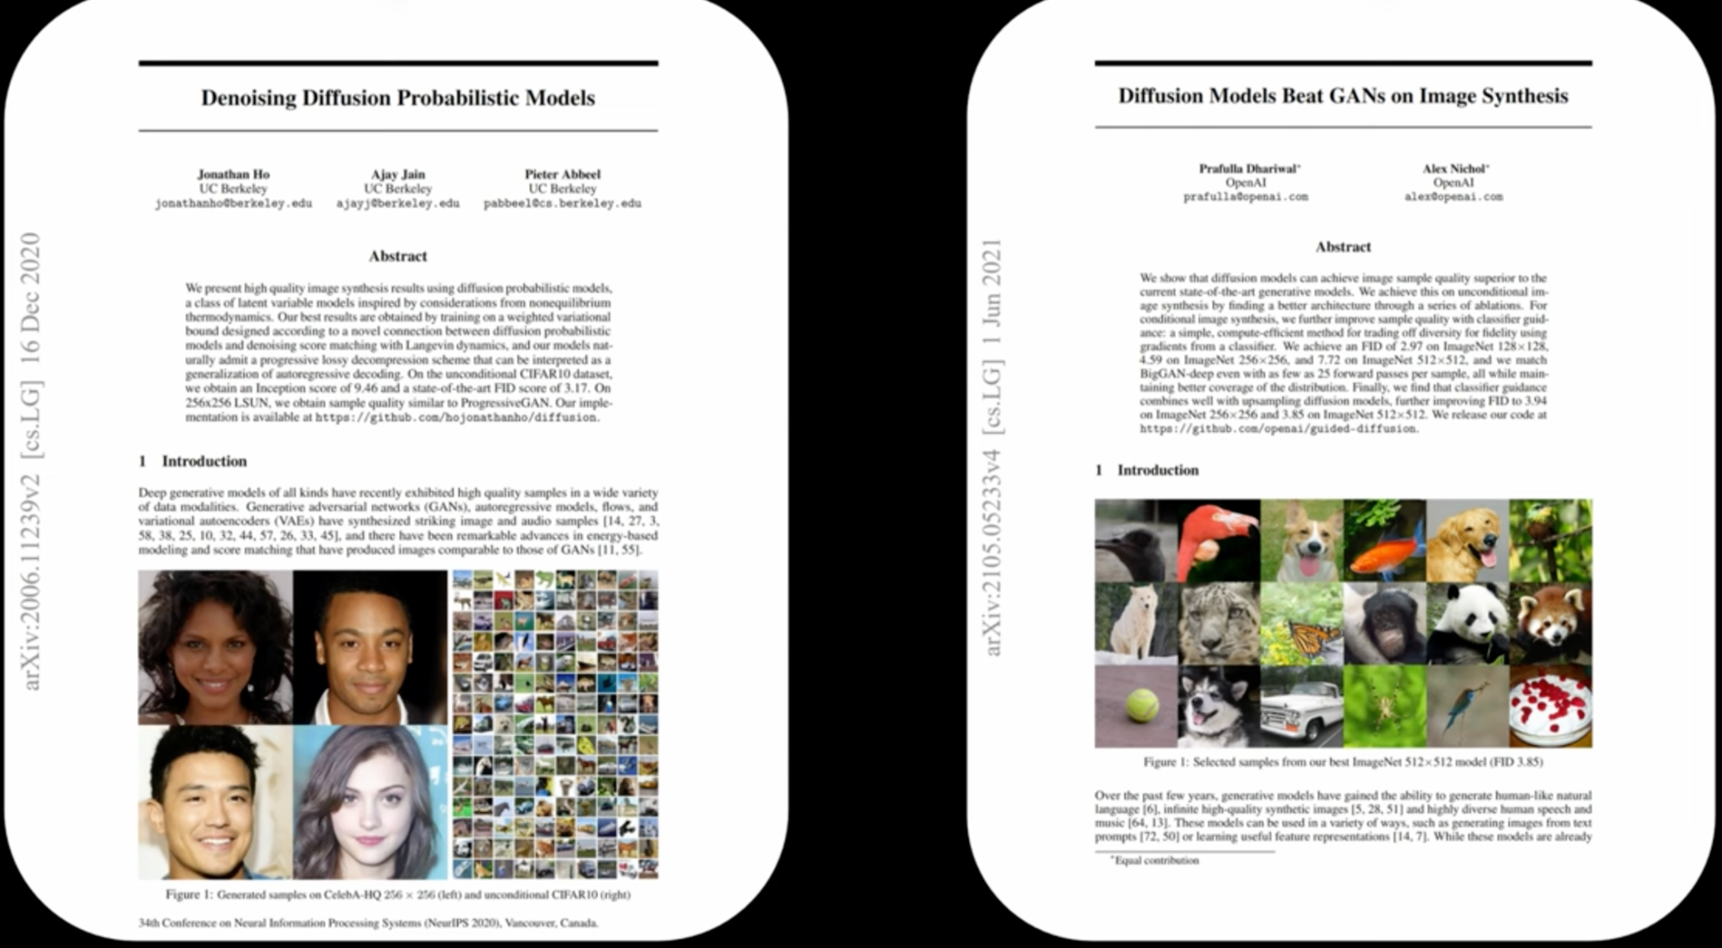
Stable Diffusion: Revisit from Scratch
Synopsis: Diffusion Model, learns to Predict Noise via UNet, which we remove from Current Image to Find Less Noisy Image. This is done many times to reach acceptable Image.
We are going to discuss math, Concepts and Learning from papers below: DDPM: https://arxiv.org/pdf/2006.11239.pdf
DDPM Improved: https://arxiv.org/pdf/2105.05233.pdf
Build understanding and Code needed to train Diffusion Model from Scratch.
Train Diffusion Model on Fashion MNIST dataset to generate sample images.

Slide 12
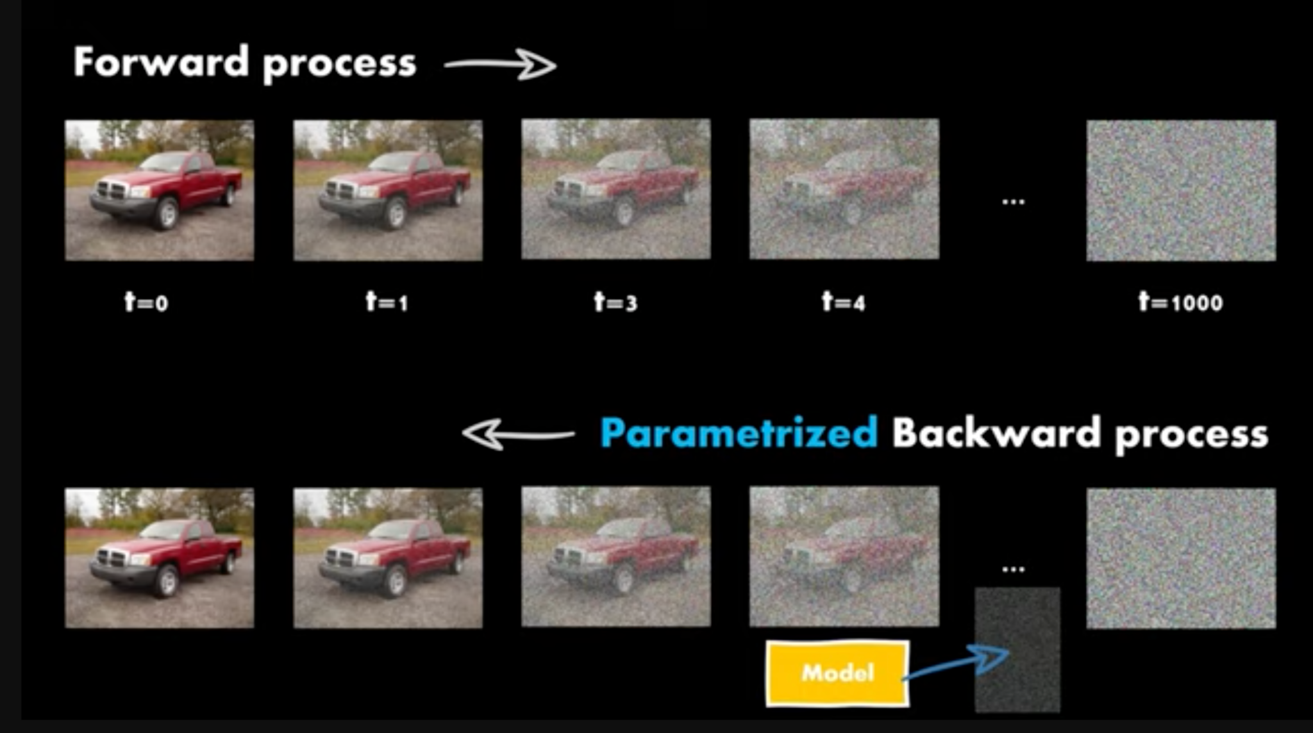
Stable Diffusion: Naming Convention
This is the Diffusion Model. Note few things for Math:
Iterations of Noise Applications or Estimation are called “Timesteps t” in paper. WTH name!
t=0 means Original or Subject Image.
As ‘t’ increases to 1, 2, 3.…T, Noise Increases.
So, How we train a model like this?

Slide 13
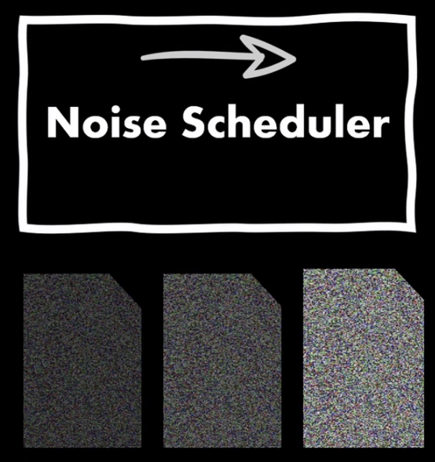
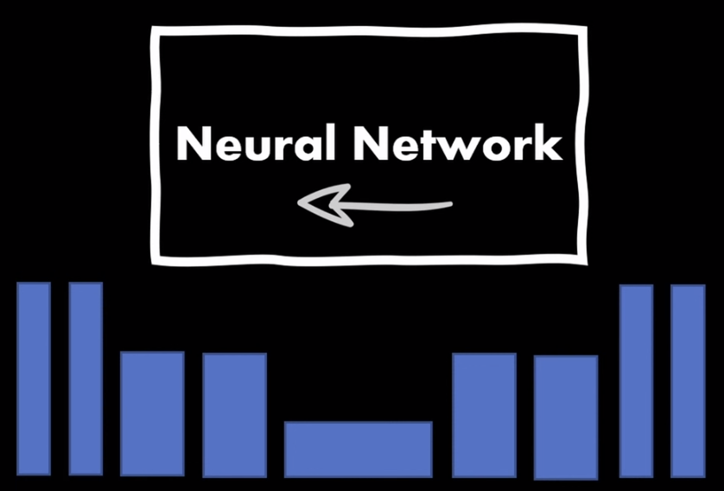
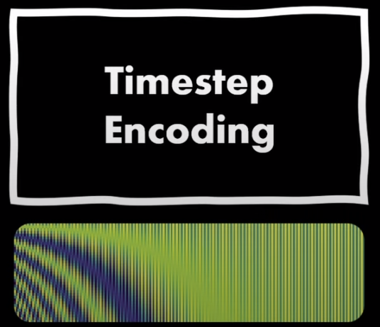
Diffusion Model: What is needed?
During forward process, to create images with known noise. Adding equal amount of noise at each timestep is not most viable option.
Neural Network for noise estimation. We will use UNet as in Original paper.
Structure of UNet is subjective to the dataset being trained on.
To encode the temporal information during noising or denoising process. Amount of noise estimated depends highly on timestep t.

Slide 14
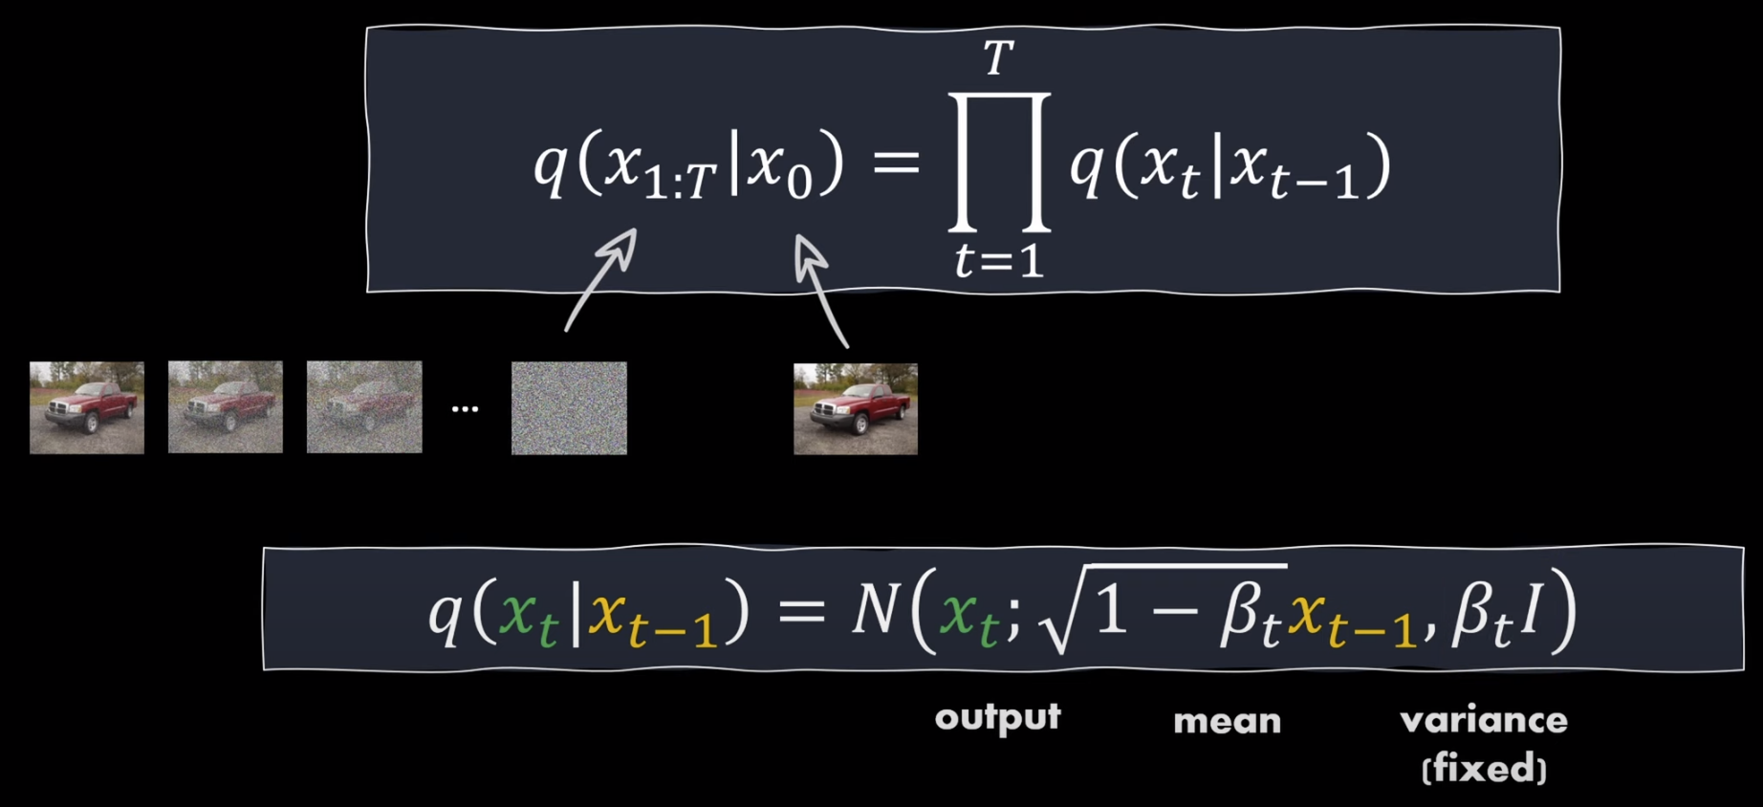
Stable Diffusion: Forward Process
Noised version at timestamp ‘t’ is given as: q( x_{T}|x₀ )
β_{t} is variance at step ‘t’
Next Noised version from current image is indicated as: q( x_{t} | x_{t-1} )
β_{t} is chosen as per noise schedule at t. More on this in a bit.
Cumulative Production is for efficiency.
1-β_{t} : this mean value says, higher variance will have pixels shifted more.

Slide 15
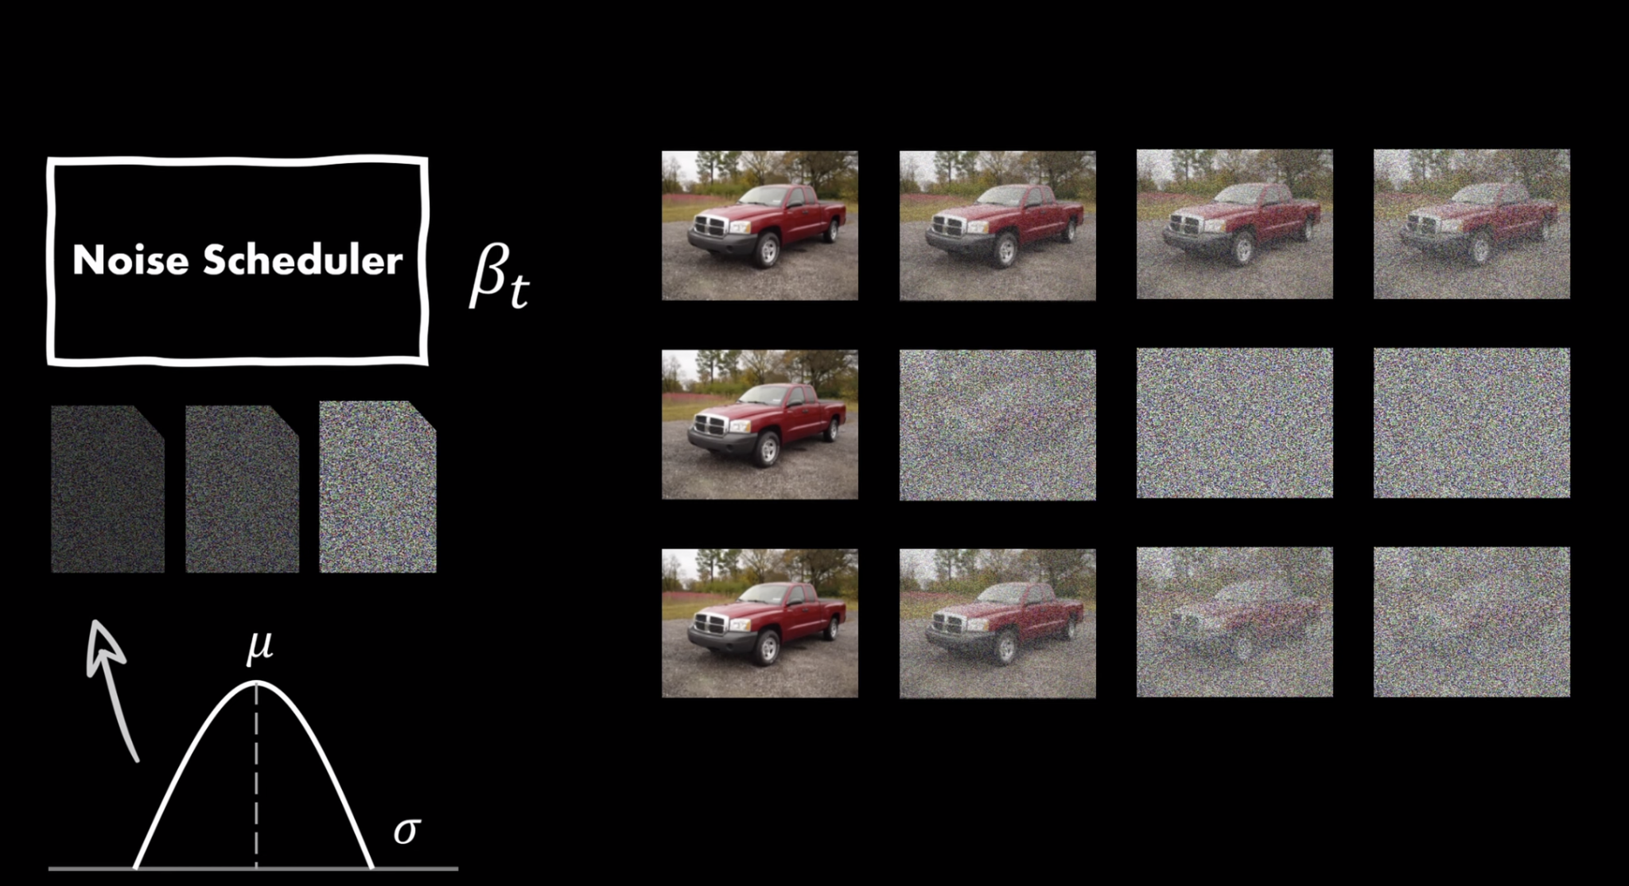
Stable Diffusion: Noise Schedule
In Forward Process, Target of Adding noise is to: Move toward Perfect Gaussian Noise Image with μ = 0 and σ = 1.
Noise Schedule matters a lot as it determined if images see by the model become: Too Noisy, Too Early
Many Noise Schedules are discussed in paper as: Sinusoidal, Quadratic, Linear
We will use Linear Noise Schedule.

Slide 16
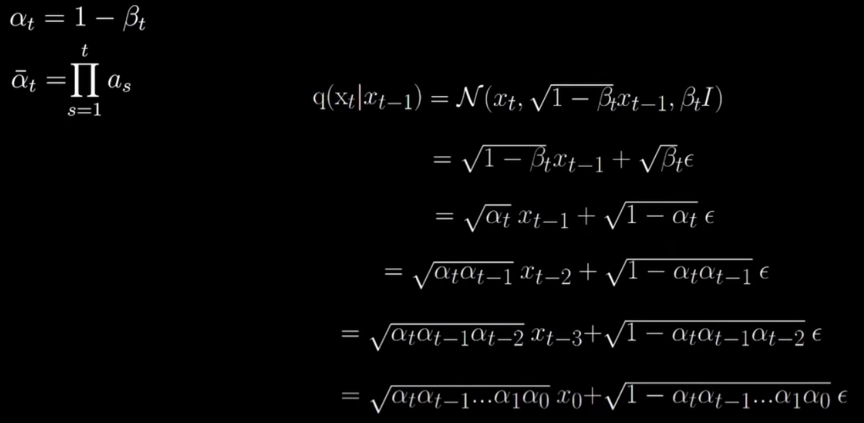
Stable Diffusion: Noisy Image at ‘t’
Paper explains like this to get get noisy Image at timestamp t
Absolutely WTH way of writing the intuition.
It is more of WTF!
Let’s Simplify for lesser mortals like us on next slide.

Slide 17
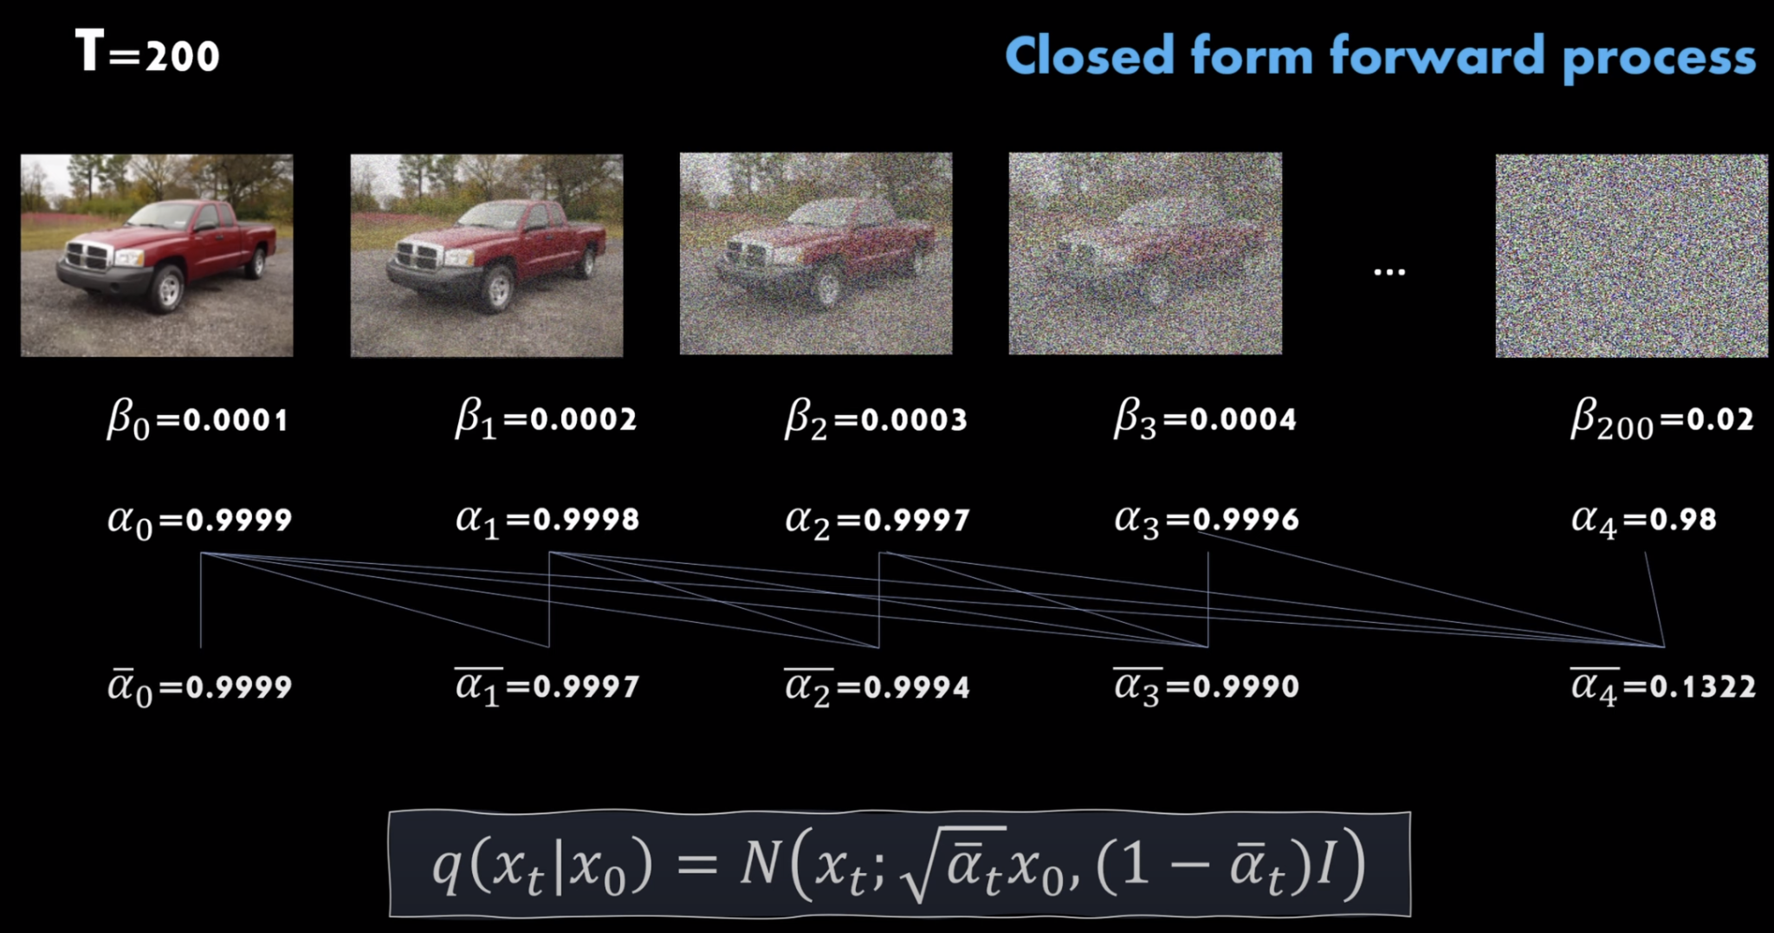
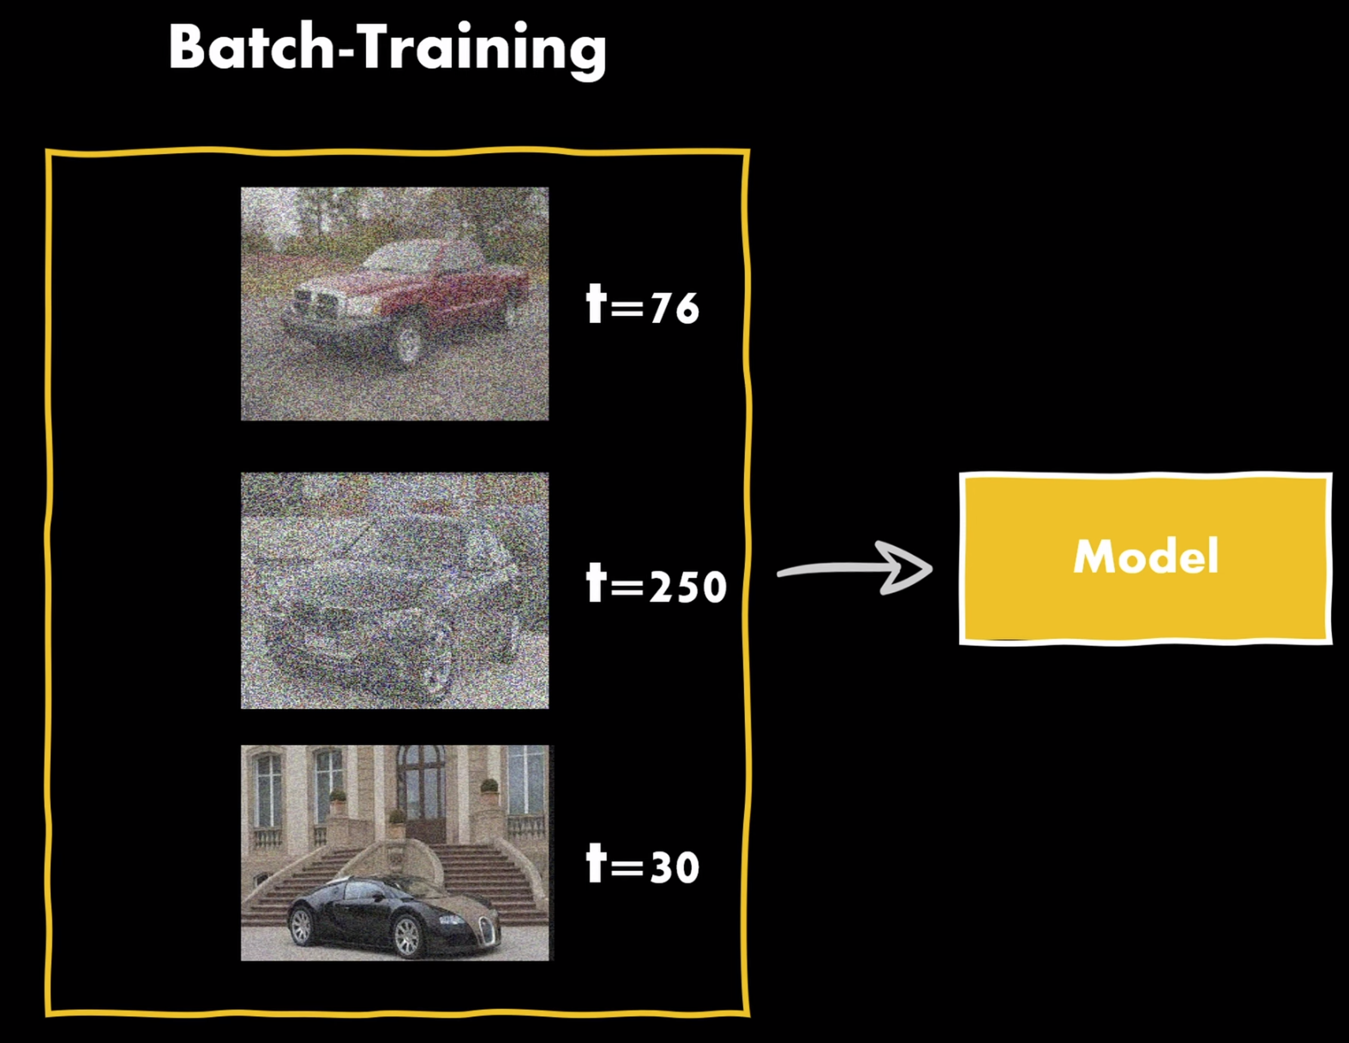
Stable Diffusion: Noisy Image at ‘t’
For efficiency, We can directly calculate x_{t} by using cumulative product of 1-β.
So, we do not have to calculate intermediate noisy images to find ultimate noise image at time t.
This is has much more deeper benefits in efficiency as this enables us to sample any amount of noise out of order and more stochastic introduction in training.
α = 1- β , where β is variance.
ᾱ is Cumulative products of all previous α
ᾱ makes is computationally efficient to get x_{t}

Slide 18
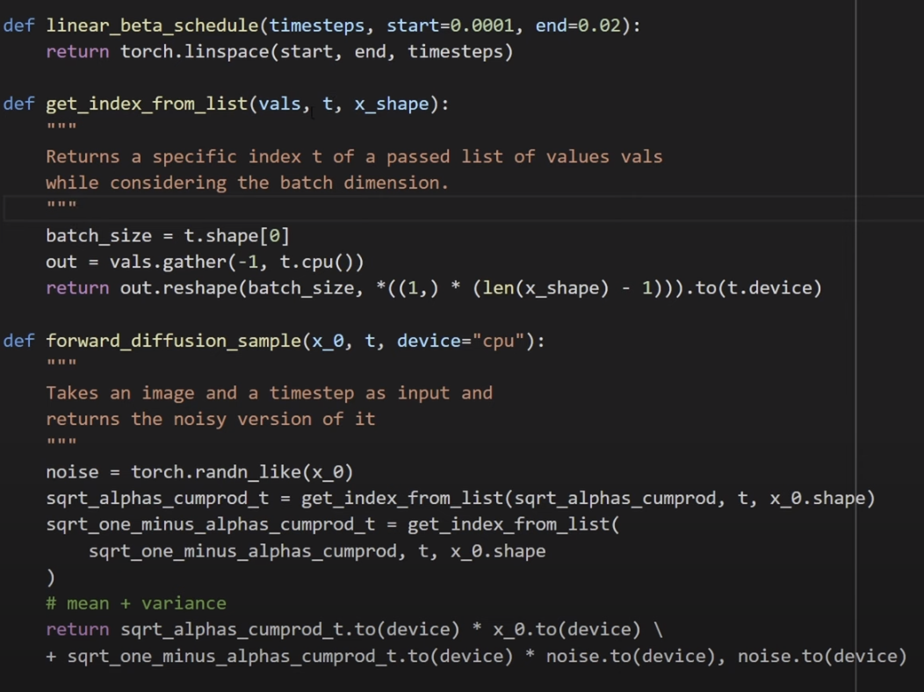
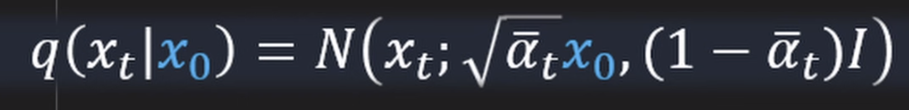
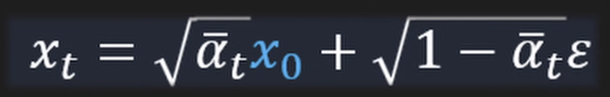
Stable Diffusion: How about Code?
Forward Process code:
linear_beta_schedule(): Provides list of betas for timesteps 0,1,2,...T
get_index_from_list(): Simple utility function to get index values
forward_diffusion_sample(): get the noised image for timestep t passed in function as discussed:

Slide 19
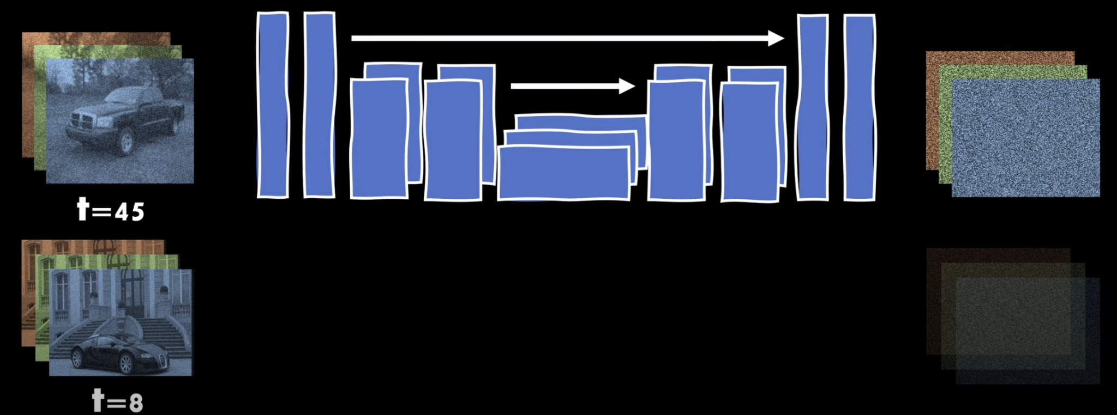
Diffusion Model: UNet for Noise Estimation
UNet is used to estimate amount of “Noise”, not the original image.
Note t = 8 has less noise, while t = 45 has lot of noise.
As in Image above, UNet is supposed to have temporal component encoded additionally.
UNet can take any architecture, But use the one which matches our data at hand.

Slide 20
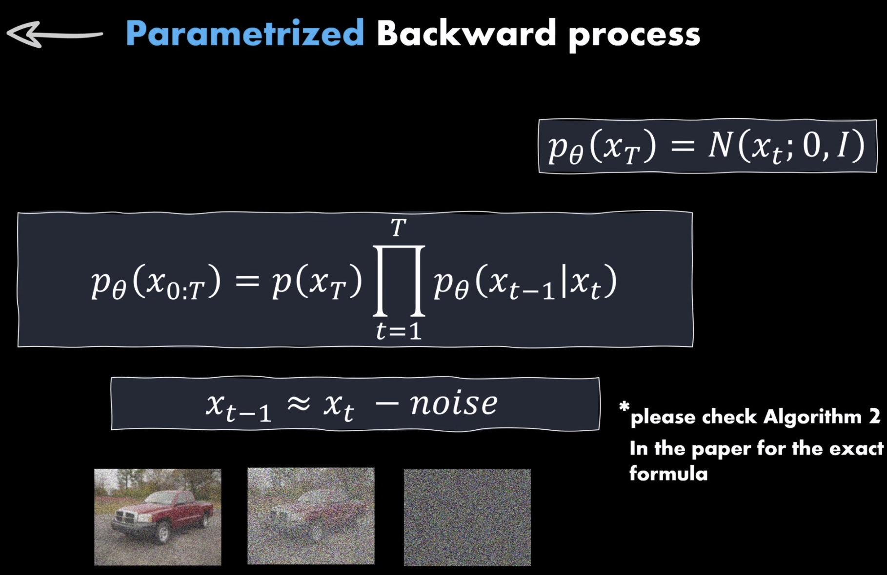
Stable Diffusion: Math for Backward Process
In backward process, we want to: - Estimate the Noise at timestep ‘t’ by given image to get less noisy image at timestep ‘t-1’. Note this is opposite from backward process. - Remove noise from Image.
p_{θ}(x_{T}) is Gaussian Noisy Image from there we start backward process.
Backward process is done sequentially during prediction actually diffusion post training.
UNet gets fitted(i.e. Back-propagated) by Loss between Estimated Noise and Actual Noise as per Noise schedule chosen.

Slide 21
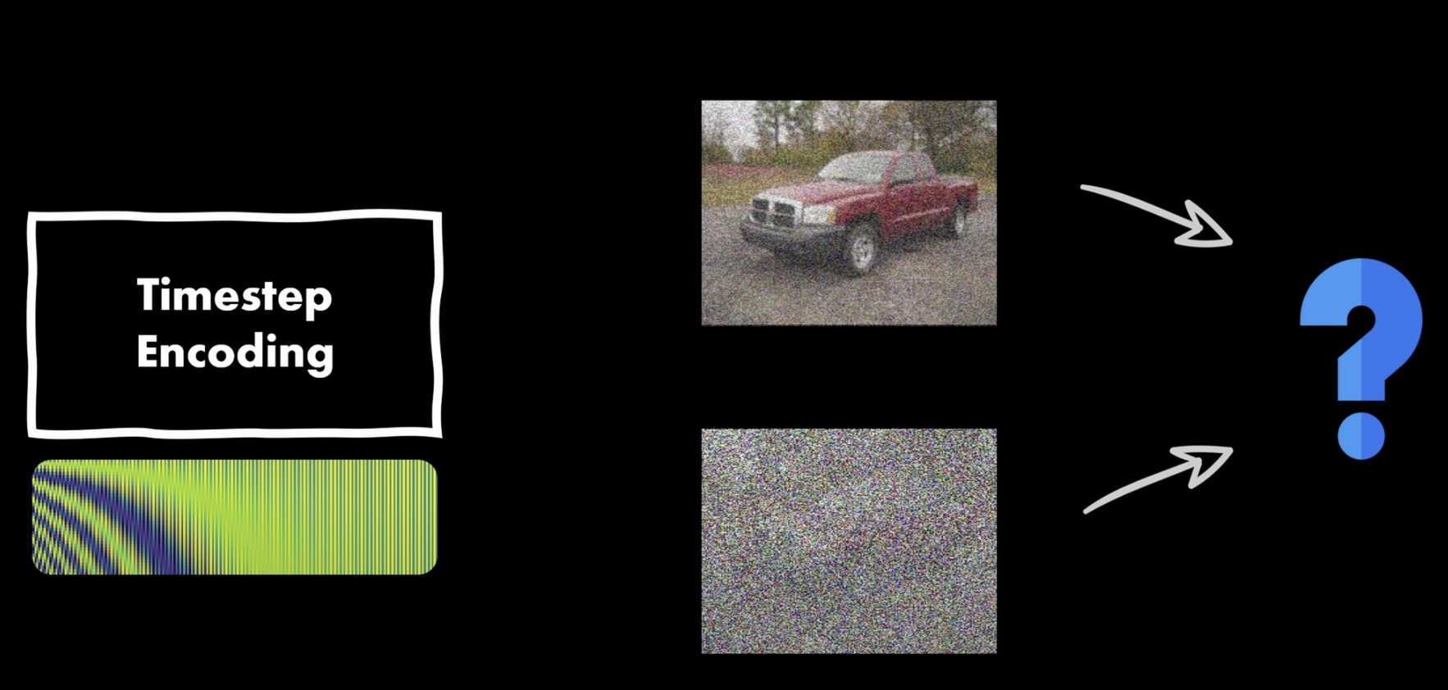
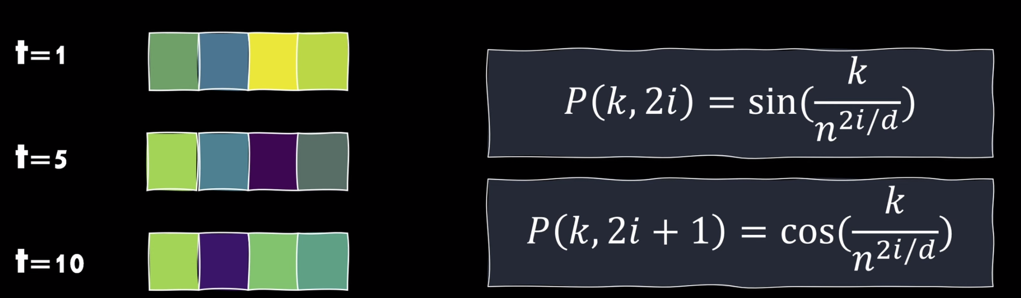
Diffusion Model: Positional Encoding
Shared UNet is used to estimate Noise for all timesteps t.
How much noise in any image is decided by: - Current Image x_{t} - Current timestep t.
So, To estimate the amount of noise, authors of the DDPM paper have used Positional Embedding. This is similar to Transformer’s Attention block’s Positional Embedding input.
This position is encoded to indicted the timestep as show here.
This positional encoding is additional input to diffusion model.

Slide 22
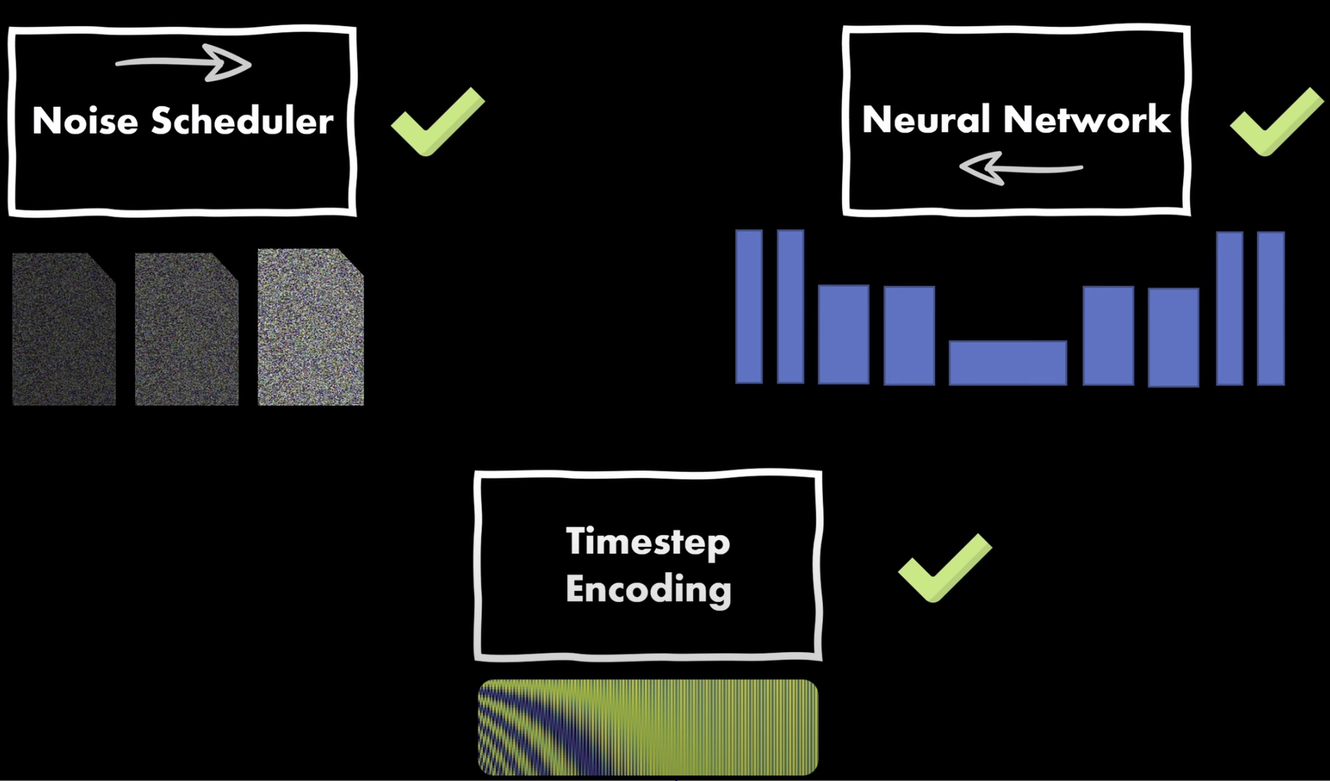
Diffusion Model: All Three Components
All Three components are: - Noise Scheduler: Linear - UNet for Noise Estimation - Timestep as positional encoding vector.
Lets see how these components work together to learn: DDPM: Denoising Diffusion Probabilistic Model
Train Diffusion Model on Fashion MNIST.

Slide 23
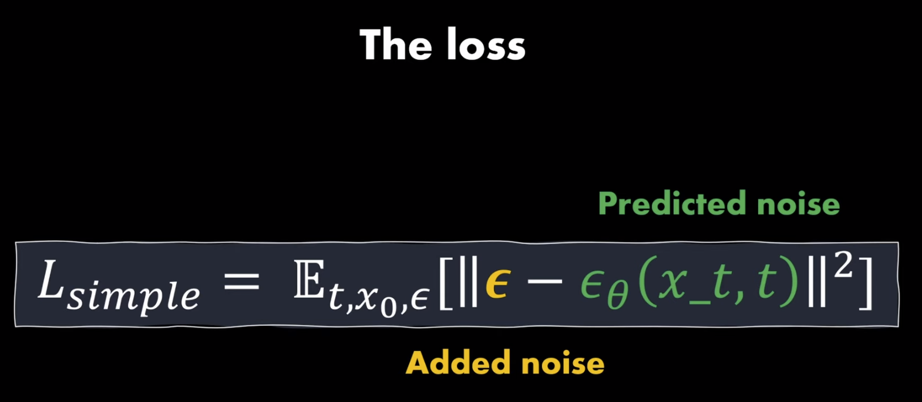
Diffusion Model: Finally, The Loss
The loss function is ultimate measure of how well if the UNet doing.
Inspired by VAE’s Loss function.
It has deeper Mathematical explanation. Please refer to DDPM paper.
But it is easy to code and develop Diffusion Model’s Intuition.
It is simply: Expected Value of L2 Loss between Actual and Estimated Noise.
L1 loss can also be used.

Slide 24
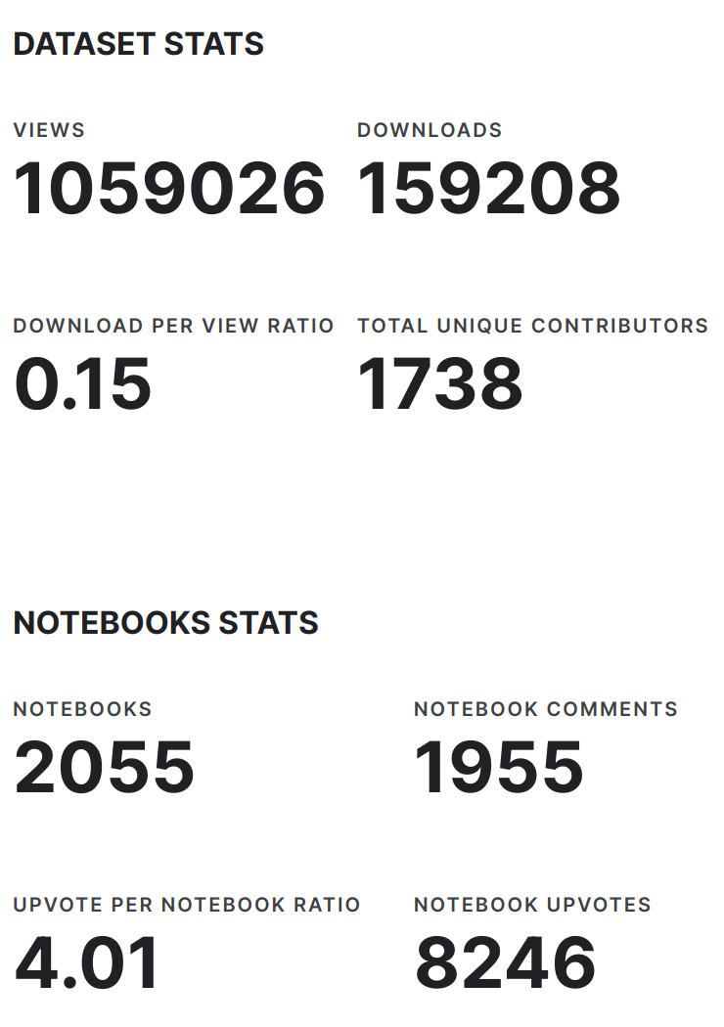
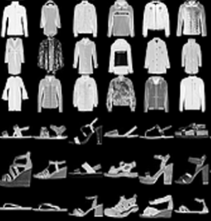
Diffusion Model: Fashion MNIST Dataset
Very Popular Toy Dataset to benchmark algorithms.
Available in TorchVision by default.
Dataset has: - training set of 60,000 examples - test set of 10,000 examples.
It is derived on the theme of MNIST dataset of handwritten images.
We use this dataset to create a Diffusion model, which can create fashion articles gray images from Gaussian random noise.

Slide 25

Diffusion Model: Code Walk Through
Spartans, Go for Glory!
Walk the Code in RunPod Environments. DDPM_From_Scratch.ipynb
Training for 20 Epochs.
Let them play with params.
Look back, Relax, Imbibe the intuition.

Slide 26
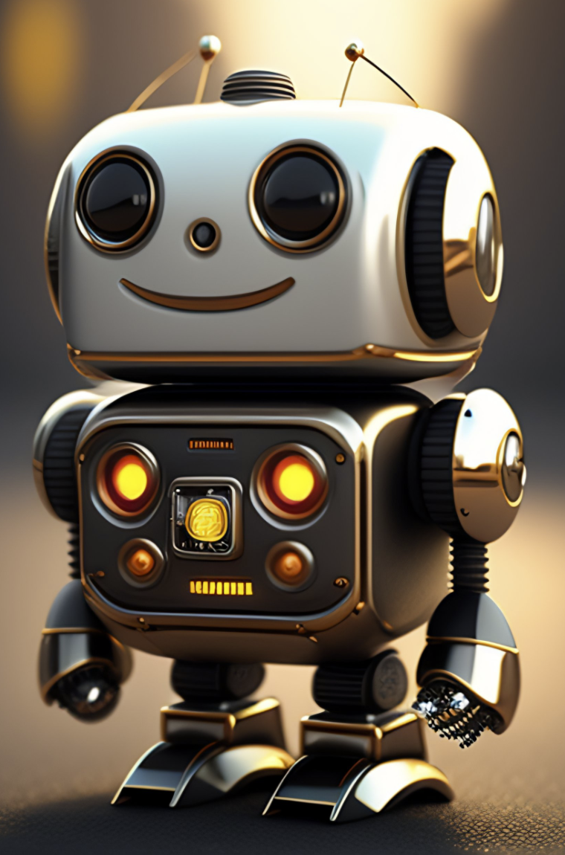
Questions?

Slide 27

!

